Slide 1
Case Study
(by Dr S Gowthaman)
Aircraft Materials
Processing – Microstructure – Property Relations
Objectives:
To present overview of materials used in aircraft structures.
To highlight the influence of processing – microstructure – property relations in certain aircraft material (polymer composites).

Slide 2
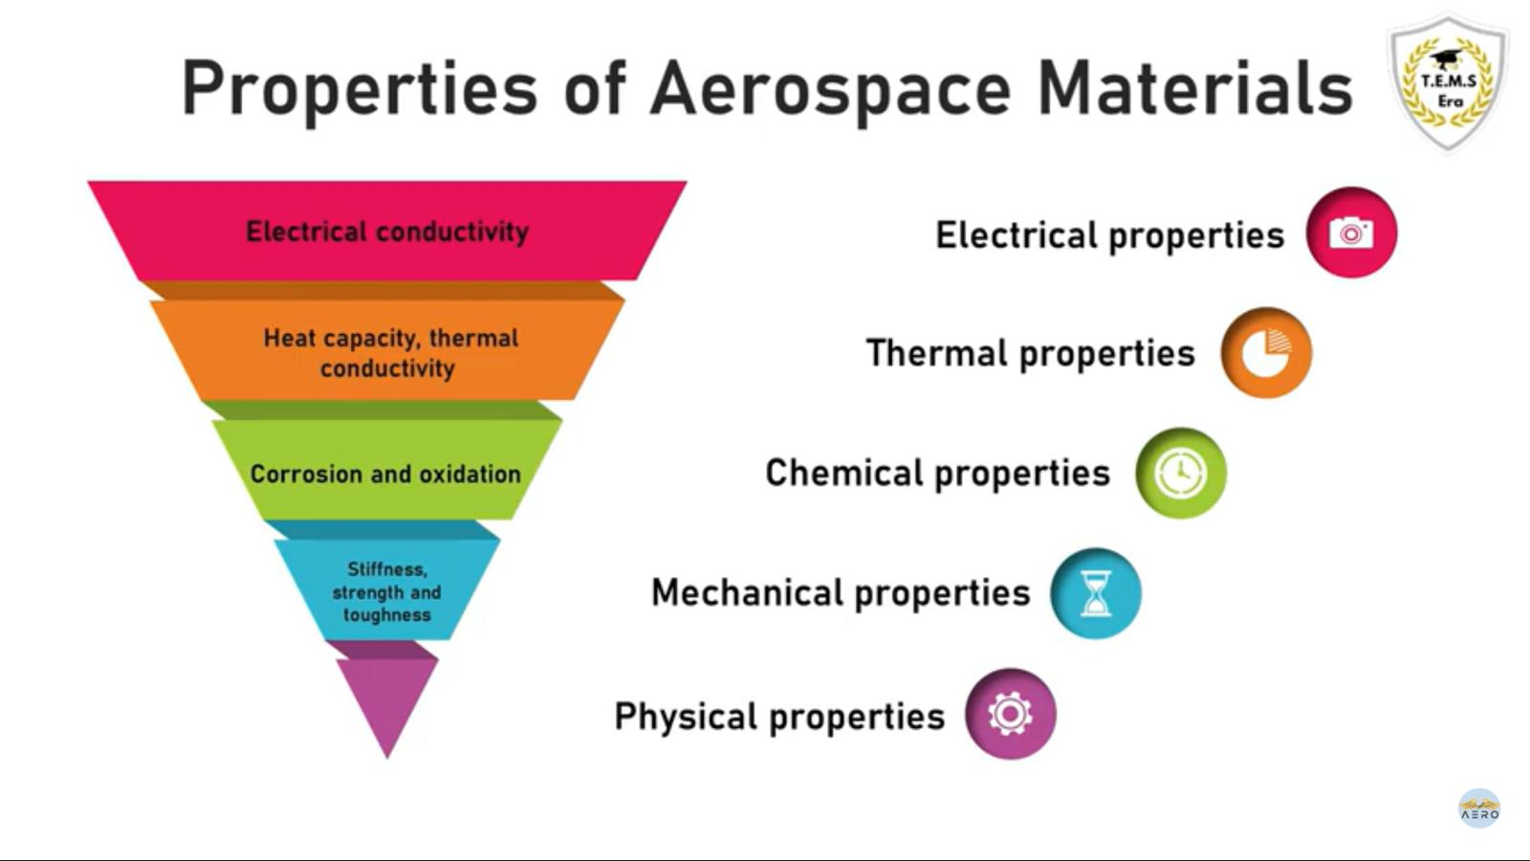

Slide 3
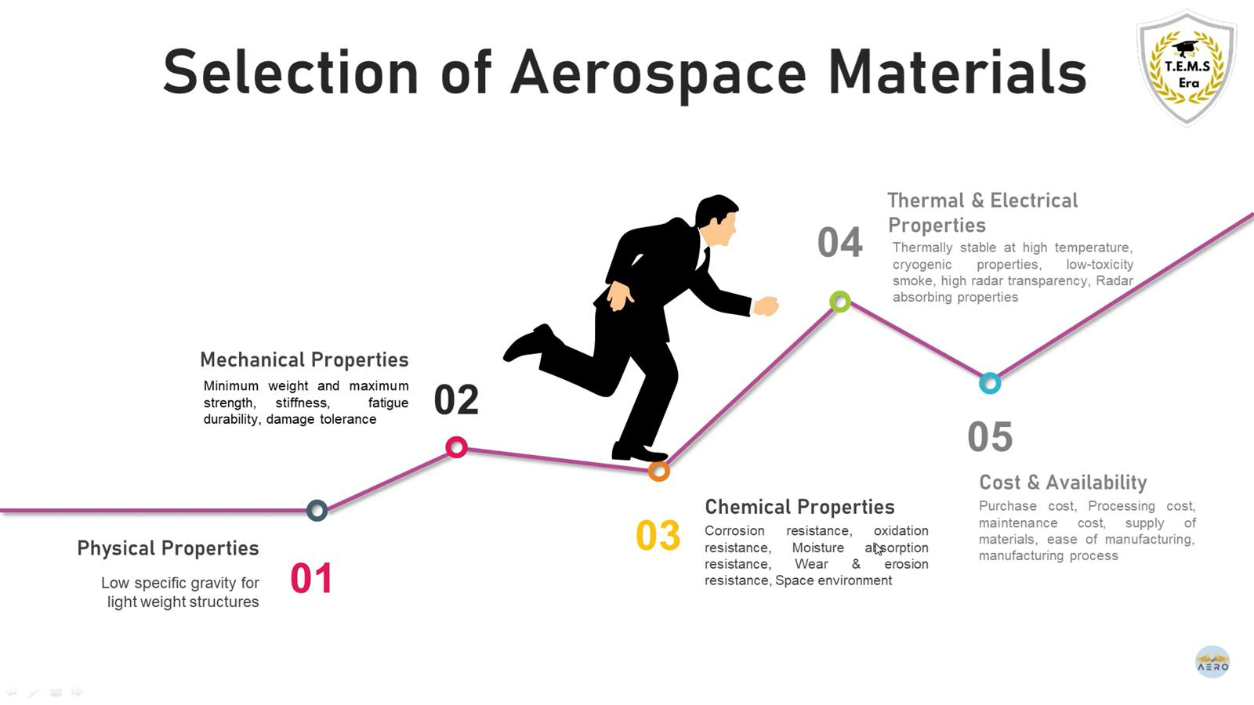

Slide 4
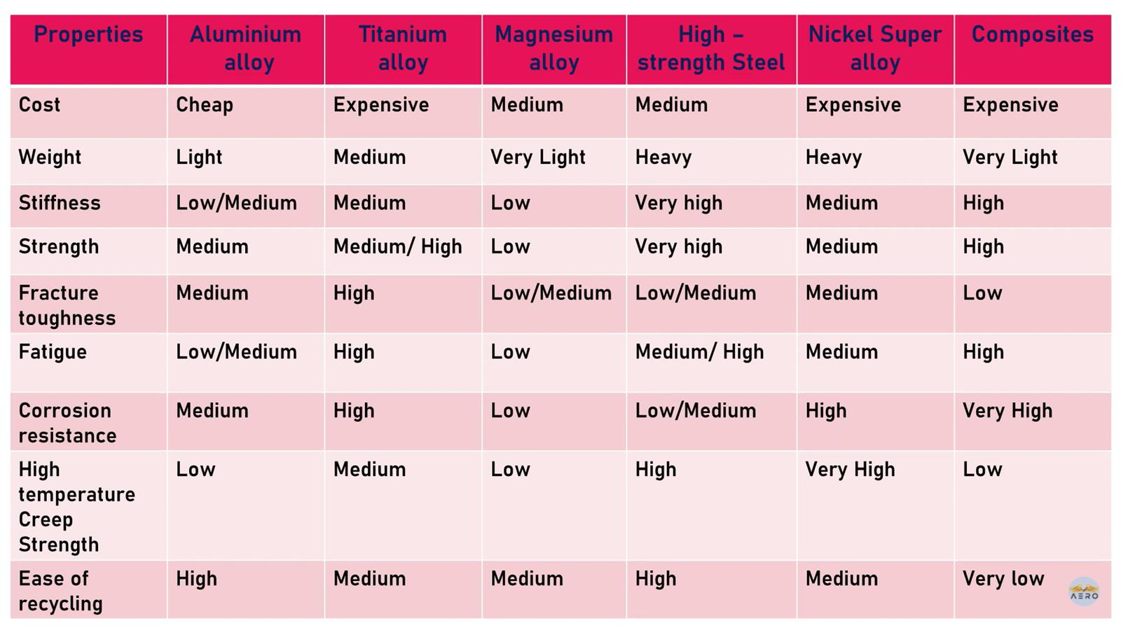

Slide 5
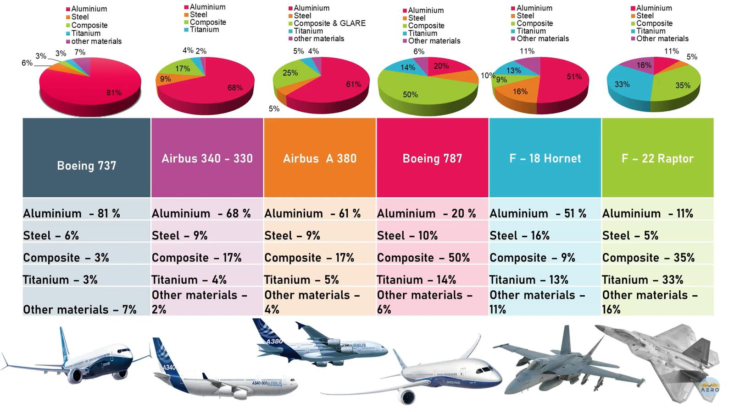

Slide 6
Composition - Processing - Microstructure - Property Relations
The properties / performance of materials are linked to:
chemical composition
processing path
microstructure of the material

Slide 7
Composition - Processing - Microstructure - Property Relations
To select a material for a particular component, the designer must have an intimate knowledge of what properties are required – Designers should be aware of various materials available and their mechanical, thermal, electronic, and other properties.
Example mechanical properties:
Strength
Tensile strength (ultimate strength)
Yield strength
Compressive strength
Hardness
Toughness
Notch toughness
Fracture toughness
Ductility
Total elongation
Reduction in area
Fatigue resistance
Example other properties:
Formability
Drawability
Stretchability
Bendability
Wear resistance
Abrasion resistance
Galling resistance
Sliding wear resistance

Slide 8
Composition - Processing - Microstructure - Property Relations
In the selection process, what is required for one application may be totally inappropriate for another application.
Example: Steel beams for a railway bridge
Certain Requirements:
Strength to withstand the loads.
Fracture toughness to resist crack growth
Weldability with other steel beams (need low carbon)
Example: Steel rails
Certain Requirements:
High strength
Wear resistance
Chosen material: Modern rail steels consist of a fully pearlitic microstructure with a fine pearlite interlamellar spacing. Pearlite is unique because it is a lamellar composite consisting of 88% soft, ductile ferrite and 12% hard, brittle cementite (Fe3C). The hard cementite plates provide excellent wear resistance, especially when embedded in soft ferrite. Pearlitic steels have high strength and are fully adequate to support heavy axle loads of modern locomotives and freight cars.
Chosen material: HSLA steel has a ferrite-pearlite microstructure and is microalloyed with vanadium and/or niobium for strengthening.
(Microalloying is a term used to describe the process of using small additions of carbonitride forming elements--titanium, vanadium, and niobium--to strengthen steels by grain refinement and precipitation hardening.)
So, the requirements for these applications are different and hence the information on processing – microstructure – property relations help designers.
Ferrite-pearlite microstructure
Fully pearlite microstructure

Slide 9
In this case study, we will discuss
Composition - Processing - Microstructure - Property relations in a certain aircraft material which will be useful for designing of aircraft structures…..
Material to be discussed – Polymer composites (PMCs)

Slide 10
Polymer Matrix Composites
Compositions influence the type of processing and resulting microstructure / properties……..
Possible Compositions
Possible Reinforcement Forms
Fiber reinforcements
Inorganic
Glass
Boron/tungsten wire
Silicon carbide
Organic
Aramid (Kevlar)
Carbon
Graphite
Matrix materials
Thermoplastic
Polyester
Polyamide
Polysulfone
Thermoset
Epoxy
Phenolic
Polyester
Polyimide
Bismaleimide
Pitch
Fillers
Powder
Silica
Carbon
Microballoon
Phenolic
Carbon
Glass
Metal
Stainless steel alloy
Aluminum alloy
Titanium alloy
Carbon
Carbonized resin
CVD carbon or graphite
Carbon powder

Slide 11
Polymer Matrix Composites
Compositions influence the type of processing and resulting microstructure / properties……..
Density
Strength
Modulus
Mechanical properties and service temperatures for selected reinforcement fibers
Inorganic fibers: glass (maximum temperature 970 °C) and aramid (maximum temperature 500 °C).
Organic fibers: carbon (maximum temperature 2500 °C) and graphite (maximum temperature 3000 °C

Slide 12
Polymer Matrix Composites
Compositions influence the type of processing and resulting microstructure and properties……..
Density
Strength
Modulus
Mechanical properties and service temperatures for selected matrix resins
Thermoplastics: polyester (unfilled; maximum temperature 140 °C), polyamide (nylon 6/6, unfilled; maximum temperature 130 °C), and polysulfone (standard; maximum temperature 160 °C).
Thermosets: epoxy (unfilled; maximum temperature 260 °C), phenolic (unfilled; maximum temperature 230°C) and polyimide (unfilled; maximum temperature 370 °C)

Slide 13
Polymer Matrix Composites
Forms of composition influences microstructure and properties……Effect of fiber orientation on the strength of carbon-fiber/epoxy composites is shown in the Figure.

Slide 14
Polymer Matrix Composites
Type of processing influences the microstructure and properties – Glass / epoxy composites
Hand lay-up
Vacuum bagging
Vacuum infusion of resin
More air bubbles
No air bubbles
Microstructure
Less air bubbles
Microstructure
Microstructure
Properties

Slide 15
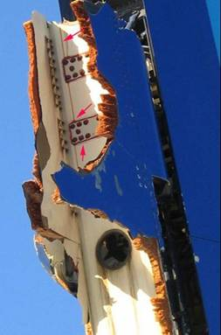

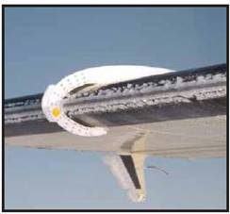
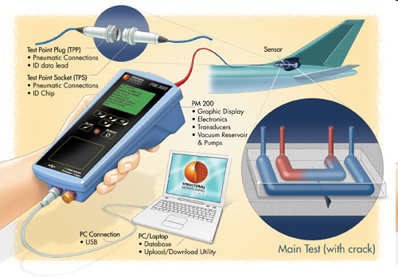
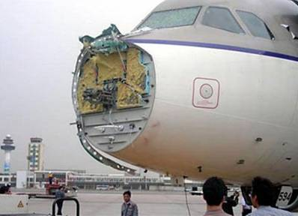

Materials Needs for Some Aircraft Applications
Still there are needs of new materials for many challenges in aircraft structures….some examples are shown below.
Problem - Structural failure
Property needed - Strength, stiffness, toughness
Problem - Structural health monitoring
Property needed - Electrical conductivity, self healing
Problem - Lightning
Property needed - Electrical conductivity
Problem - Icing
Property needed - Electrical & thermal conductivity
We will see some materials solutions for these from composition – processing – microstructure – property perspective…

Slide 16
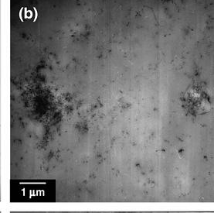
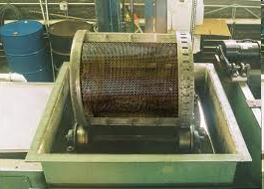
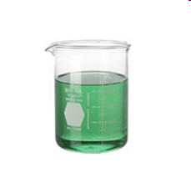
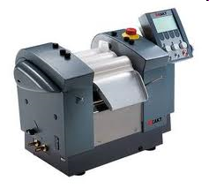
Materials Needs for Aircraft Applications (Mechanical Properties)
Composition: CNT + Epoxy + Carbon fiber composite
Processing
Microstructure
Processing of composites
Hand mix epoxy + CNT
fabric
Problem - Structural failure
Property needed - Strength, stiffness, toughness
Process in three roll mill
resin impregnation
Non uniform mixing of CNT
nanoresin
VARTM
Vacuum pump
Use nanoresin now to make composite
Property
Resulting strength, modulus of composites is not good (because of non uniform mixing of CNTs)

Slide 17
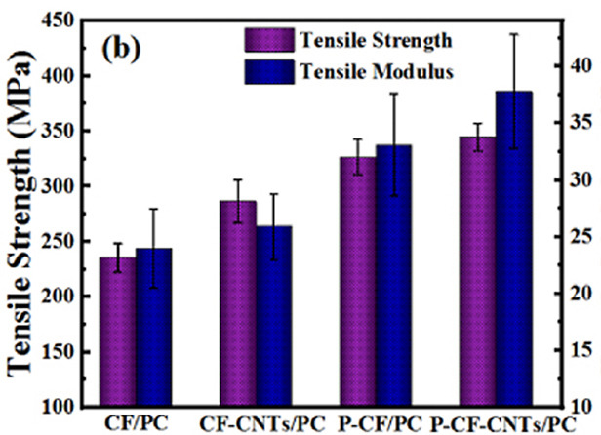
Materials Needs for Aircraft Applications (Mechanical Properties)
Composition: CNT + PC + Carbon fiber composite
Processing
Microstructure
Processing of composites
CNT coated fabric
Problem - Structural failure
Property needed - Strength, stiffness, toughness
resin impregnation
Uniform coating of CNT on fabrics
resin
Vacuum pump
VARTM
Use CNT coated fabric now to make composite
Electrophoretic deposition
Property
Resulting strength, modulus of composites is good (because uniform deposition of CNTs)
(Note - Figure shows with some chemical treatment along with CNT coatings)

Slide 18
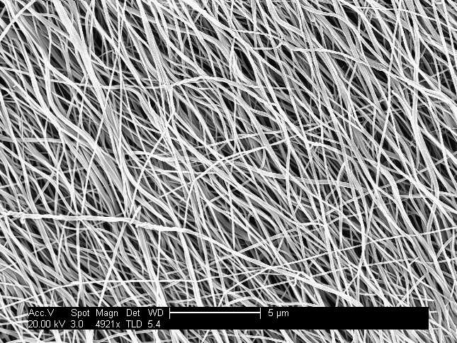
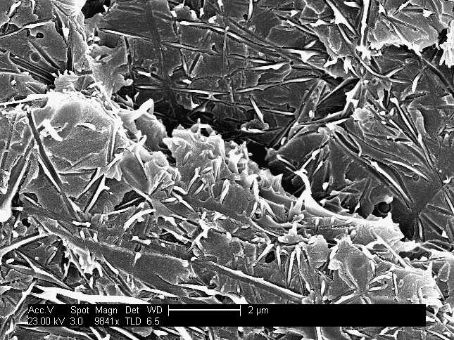
Materials Needs for Aircraft Applications (Fracture Toughness)
Composition: Nylon nanofiber + Epoxy + Carbon fiber composite
Processing
Microstructure
Processing of composites
Processing of composites
Nylon coated fabric
Problem - Structural failure
Property needed - Strength, stiffness, toughness
resin impregnation
Electrospinning
Nylon nanofibers
Fabric stacking
resin
VARTM
Vacuum pump
Use Nylon coated fabric now to make composite
Property
Fracture toughness improved by 150%
(nanofiber bridging, pull out are mechanisms)

Slide 19
Materials Needs for Aircraft Applications (Lightning Strike)
Composition: CNT + Epoxy + Carbon fiber composite
Processing
Microstructure
Processing of composites
CNT coated fabric
Problem - Lightning
Property needed - Electrical conductivity
resin impregnation
Uniform coating of CNT on fabrics
resin
Vacuum pump
VARTM
Use CNT coated fabric now to make composite
Electrophoretic deposition
Property
Increase in in-plane and out-of-plane electrical conductivity increased because of CNTs

Slide 20
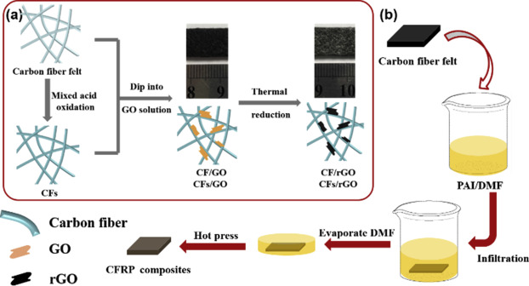
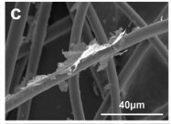
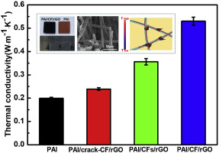
Materials Needs for Aircraft Applications (Icing)
Composition: Graphene Oxide + Polyamide + Carbon fiber composite
Processing of composites
Microstructure
Problem - Icing
Property needed - Electrical & thermal conductivity
Property
Significant improvements in thermal conductivity for composites with various chemical treatments

Slide 21

Materials Needs for Aircraft Applications (Health Monitoring)
Composition: CNT + Epoxy + Carbon fiber composite
Processing
Microstructure
Processing of composites
CNT coated fabric
Problem - Structural health monitoring
Property needed - Electrical conductivity
resin impregnation
Uniform coating of CNT on fabrics
resin
Vacuum pump
VARTM
Use CNT coated fabric now to make composite
Electrophoretic deposition
Property
Internal damages which is not shown in load-displacement curves are shown as change in resistances – beneficial to detect and monitor defects in internal structures

Slide 22
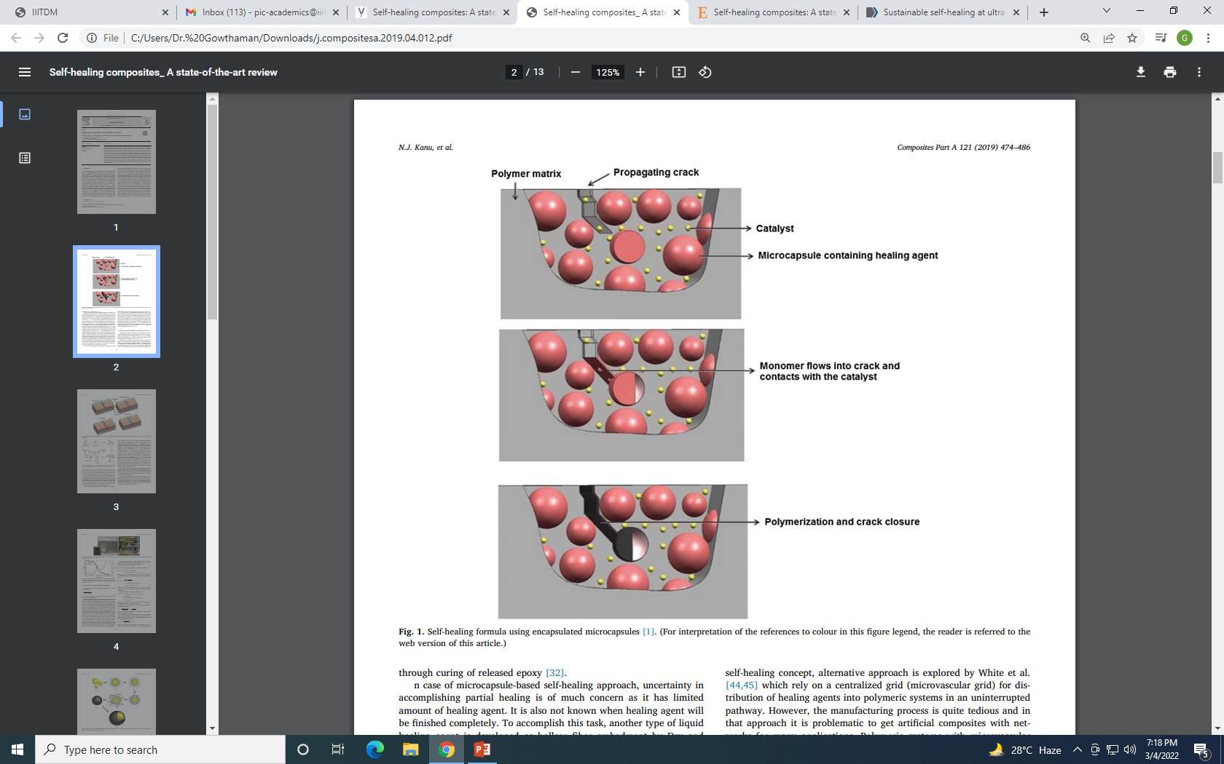
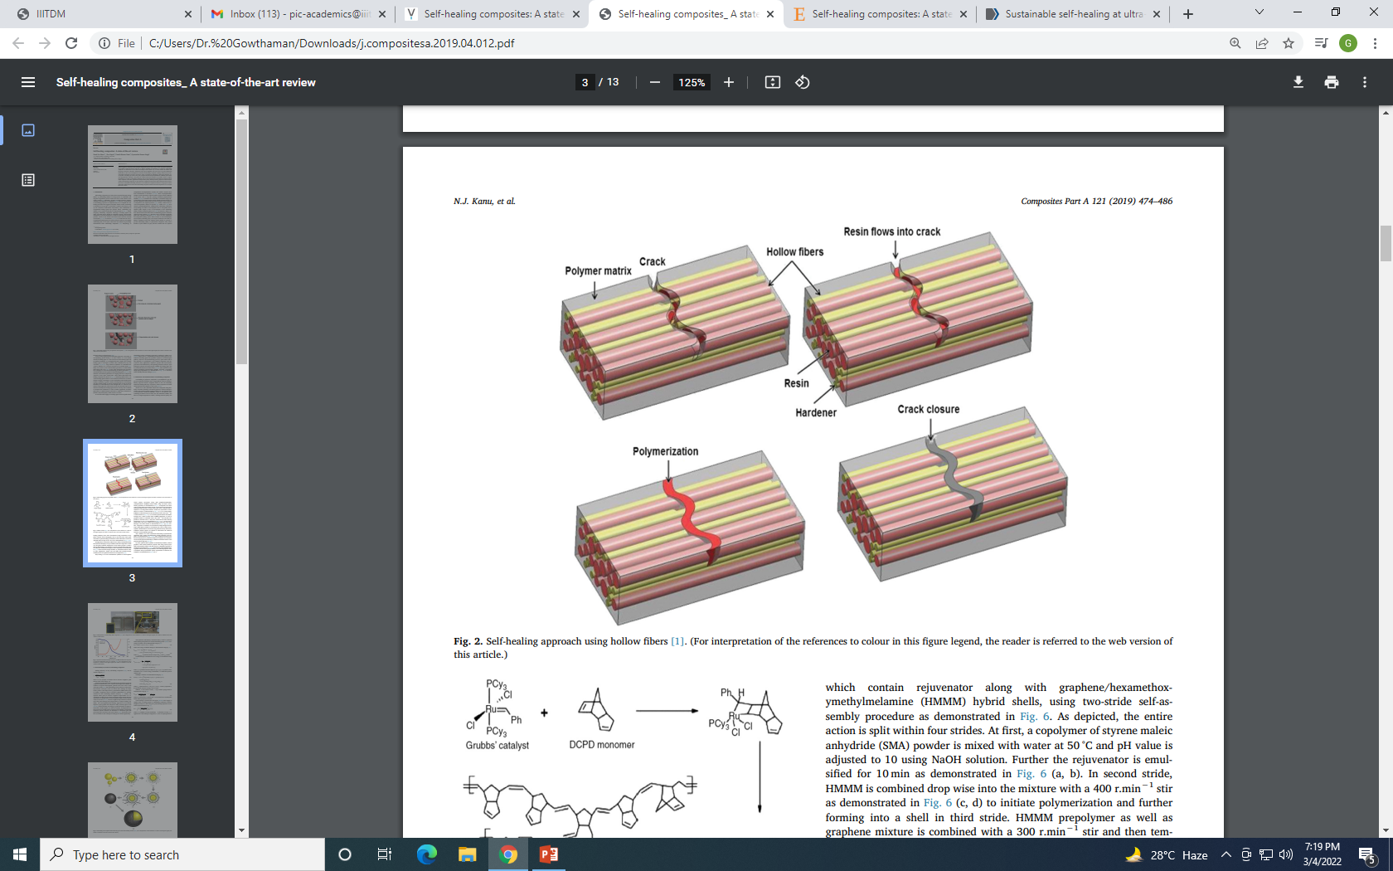
Materials Needs for Aircraft Applications (Self Healing)
Smart materials
Composition: Polymer + Self healing capsules or fibers + Carbon fibers
Microstructures
Problem - Structural health monitoring
self healing
Hollow fibers with uncured resin are used. Under cracking of fibers, resin comes out and reacts with catalyst outside. It cures and closes the cracks.

Slide 23
Outcomes:
Gain knowledge on different materials used in aircraft structures.
Understand the importance of composition - processing – microstructure – property relations in certain aircraft material (polymer composites).
Thank You

